Slide 1
Node JS
By Alan R S
May 25th, 2023

Slide 2
Agenda
Node.js - Introduction
CRUD App using Angular, Node.js and Mongo DB - Demo 1.
Node.js - Modules
Node.js - Features
Real time chat application using socket.io - Demo 2.

Slide 3
Node.js Introduction
Node.js is a server-side platform built on Google Chrome's JavaScript Engine (V8 Engine).
Node.js was developed by Ryan Dahl in 2009 and its latest version is v20.02.0.
Used for building fast and scalable network applications.
Node.js is released under the MIT license.
eBay, General Electric, GoDaddy, Microsoft, PayPal, Uber, Wikipins, Yahoo etc are the companies using Node.js.

Slide 4
Node.js Features
Asynchronous and Event Driven - All APIs of Node.js library are asynchronous, that is, non-blocking. It essentially means a Node.js based server never waits for an API to return data. The server moves to the next API after calling it and a notification mechanism of Events of Node.js helps the server to get a response from the previous API call.
Very Fast − Being built on Google Chrome's V8 JavaScript Engine, Node.js library is very fast in code execution.
Single Threaded but Highly Scalable − Node.js uses a single threaded model with event looping. Event mechanism helps the server to respond in a non-blocking way and makes the server highly scalable as opposed to traditional servers which create limited threads to handle requests. Node.js uses a single threaded program and the same program can provide service to a much larger number of requests than traditional servers like Apache HTTP Server.
No Buffering - Node.js applications never buffer any data. These applications simply output the data in chunks.

Slide 5
Where to use Node.js
Data Streaming Applications.
Data Intensive Real-time Applications (DIRT)
JSON APIs based Applications
Single Page Applications

Slide 6
How Node Works
Single Thread
Request
Request
Request

Slide 7
How Node Works
Blocking & Non Blocking
Blocking is when the execution of additional JavaScript in the Node.js process must wait until a non-JavaScript operation completes. This happens because the event loop is unable to continue running JavaScript while a blocking operation is occurring.
In Node.js, JavaScript that exhibits poor performance due to being CPU intensive rather than waiting on a non-JavaScript operation, such as I/O, isn't typically referred to as blocking. Synchronous methods in the Node.js standard library that use libuv are the most commonly used blocking operations. Native modules may also have blocking methods.
All of the I/O methods in the Node.js standard library provide asynchronous versions, which are non-blocking, and accept callback functions. Some methods also have blocking counterparts, which have names that end with Sync.

Slide 8
How Node Works
Blocking & Non Blocking
Blocking methods execute synchronously and non-blocking methods execute asynchronously.
const fs = require("fs");
const data = fs.readFileSync("/file.md"); // blocks here until file is read
And here is an equivalent asynchronous example:
const fs = require("fs");
fs.readFile("/file.md", (err, data) => { if (err) throw err; });

Slide 9
Node.js Modules
NPM is a package manager for Node.js packages.
npm install package-name
Node.js has a set of built-in modules which you can use without any further installation.
To include a module, use the require() function with the name of the module:
var http = require('http');
http: To make Node.js act as an HTTP server
os: Provides information about the operation system.
path: To handle file paths
fs: To handle the file system
HTTP Module
The HTTP module can create an HTTP server that listens to server ports and gives a response back to the client.
var http = require('http'); //create a server object: http.createServer(function (req, res) { res.write('Hello World!'); //write a response to the client res.end(); //end the response }).listen(8080); //the server object listens on port 8080

Slide 10
Node.js Modules
FS Module
The Node.js file system module allows you to work with the file system on your computer.
To include the File System module, use the require() method:
var fs = require('fs');
Common use for the File System module:
Read files
Create files
Update files
Delete files
Rename files
var http = require('http'); var fs = require('fs'); http.createServer(function (req, res) { fs.readFile('demofile1.html', function(err, data) { res.writeHead(200, {'Content-Type': 'text/html'}); res.write(data); return res.end(); }); }).listen(8080);

Slide 11
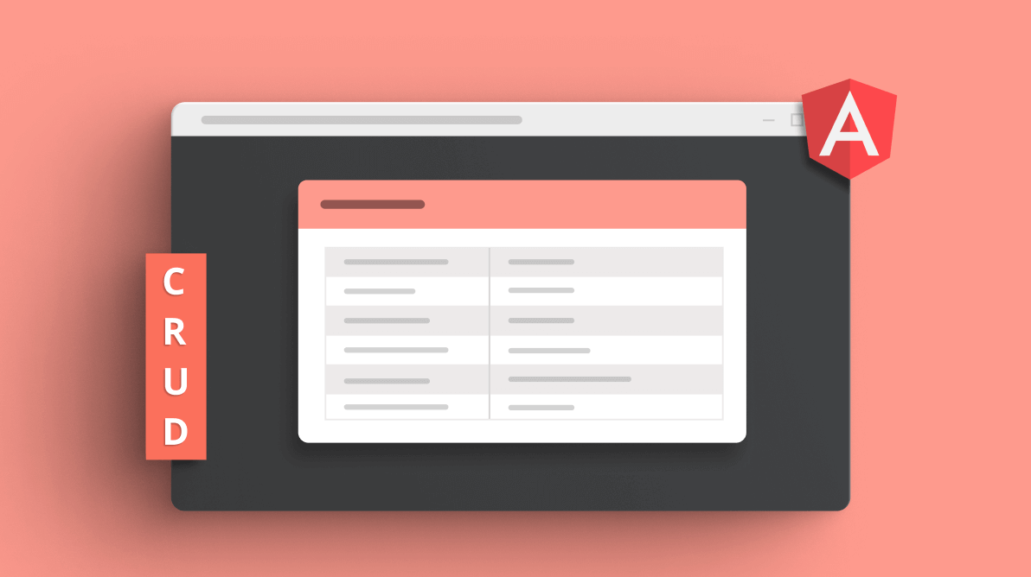
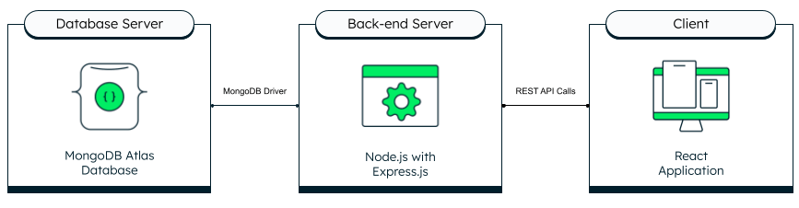
CRUD Project Using Node JS ,Angular and Mongo DB.
Angular

Slide 12
Anatomy of an HTTP Transaction
Any node web server application will at some point have to create a web server object. This is done by using createServer.
const http = require('http');
const server = http.createServer((request, response) => {
// magic happens here!
});
The function that's passed in to createServer is called once for every HTTP request that's made against that server, so it's called the
request handler. In fact, the Server object returned by createServer is an EventEmitter, and what we have here is just shorthand for
creating a server object and then adding the listener later.

Slide 13
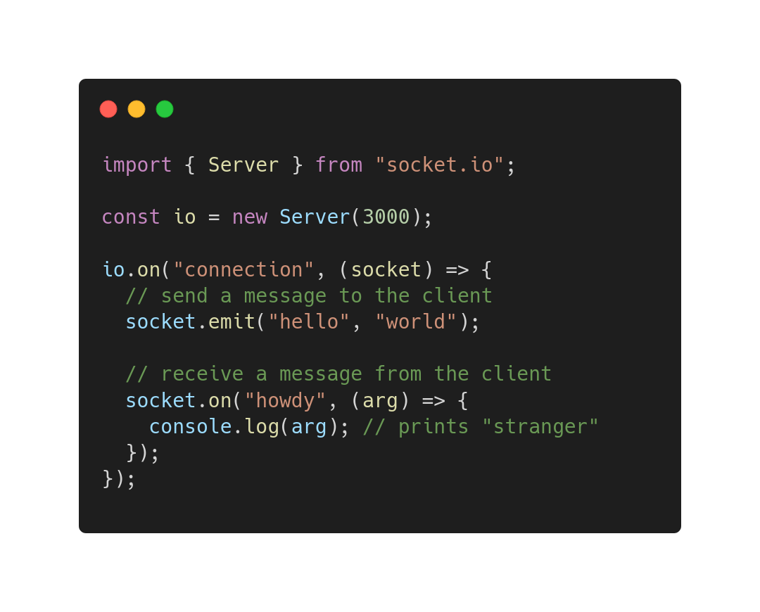
Real time chat application using socket.io
Socket.io
Socket.IO is a library that enables low-latency, bidirectional and event-based communication between a client and a server.
It is built on top of the WebSocket protocol and provides additional guarantees like fallback to HTTP long-polling or automatic reconnection.

Slide 14
Node.js Express
Express js is a very popular web application framework built to create Node.js Web based applications.
It provides an integrated environment to facilitate rapid development of Node based Web applications.
Express framework is based on Connect middleware engine and used Jade html template framework for HTML templating.
Core features of Express framework:
Allows to set up middlewares to respond to HTTP Requests.
Defines a routing table which is used to perform different action based on HTTP method and URL.
Allows to dynamically render HTML Pages based on passing arguments to templates.

Slide 15
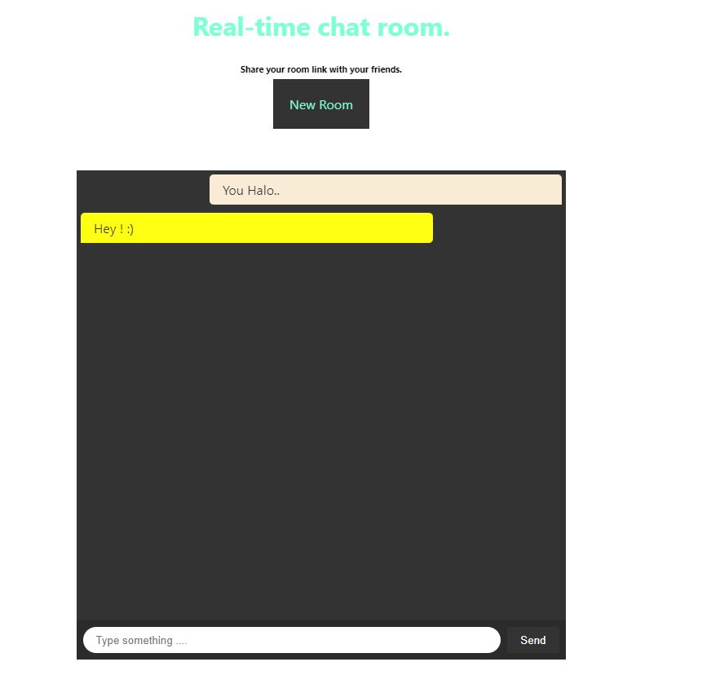
Real time chat application using socket.io

Slide 16
Reference links
https://www.digitalocean.com/community/tutorials/node-js-architecture-single-threaded-event-loop
https://v8.dev
https://nodejs.org/en/docs/guides/blocking-vs-non-blocking
https://socket.io/docs/v4
https://ejs.co
https://www.w3schools.com/nodejs/ref_modules.asp
https://www.npmjs.com/

Slide 17
Thank You

